Slide 1




Slide 2

<course name>
What are you going to learn?
Why this online program?
During the course <course name> you will use the TrainTool program <program title>.
This program focuses on developing your communication skills in the field of <name skills>.
<reason>
<reason>
<reason>
<reason>

Slide 3

What is TrainTool?
TrainTool is an online learning environment that allows you to practice communication skills.
You can prepare by watching videos containing theory and examples, subsequently you can practice by means of video role plays. You watch a video and respond to that the same way you would during a real conversation. You record your reaction, which you can watch and assess. You can also ask feeback of you fellow students or your teacher.
Watch the video on the right for further information about our method.

Slide 4

Advantages
Practice when, where and as often as you like;
Practice on a device of your choice (pc, laptop, tablet, smartphone);
Practice in a safe environment;
Available at all times.

Slide 5

Practice in TrainTool

Slide 6

What is expected of you?
Week | Action | Duration
Week <x> | Practice role plays <x> / segment <x> | 30 min.
Week <x> | Practice role plays <x> / segment <x> | 30 min.
Week <x> | Practice role plays <x> / segment <x> | 30 min.
Notes:
Vul hier ook in:
of en wanneer er een nulmeting/eindmeting in het programma zit
op welke momenten de studenten elkaar feedback moeten geven
op welke momenten de docent een beoordeling geeft
benoemen duidelijk de deadlines en verplichtingen

Slide 7
Feedback
Giving peer feedback
You can assess your own recordings by using the assessment criteria, but you can also ask feedback from your fellow students.
In order to do so you add them as friends in TrainTool. Click here for an instruction.
After adding friends you can ask them for feedback when you save your recordings – click here for an instruction.
Assessment by your teacher
Some role plays can be assessed by your teacher. In this case the recordings you save will be shared with your teacher automatically.

Slide 8

Golden rules of providing feedback
Good feedback always contains a compliment and a tip (start with highlighting what someone did well and then make a suggestion on what can be improved.
Formulate feedback from your own perspective (“I see that you …”).
Name concrete behaviour you see and describe the consequence of this behaviour.
Name a point of improvement.
More information about giving good feedback can be found here.

Slide 9

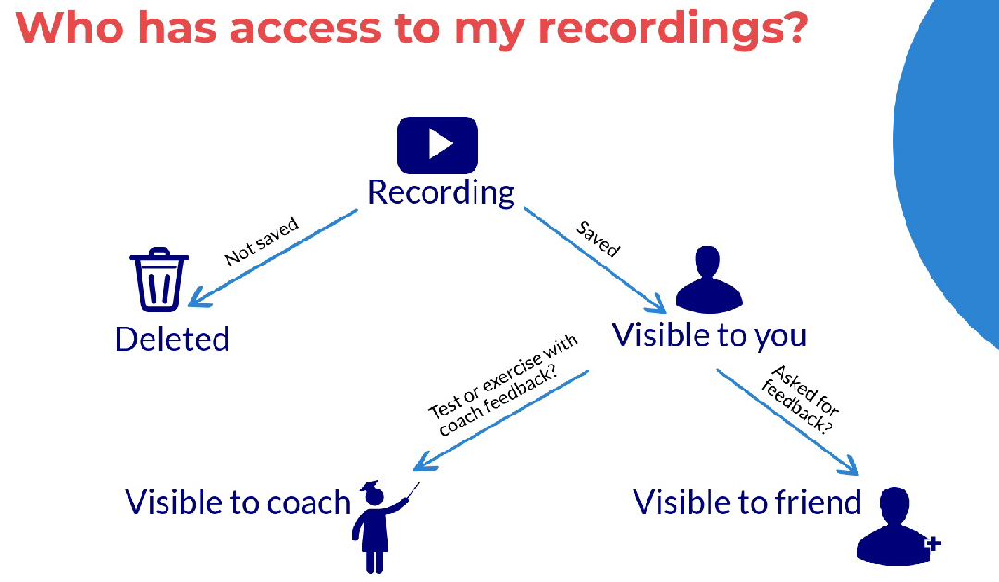

Slide 10


Slide 11
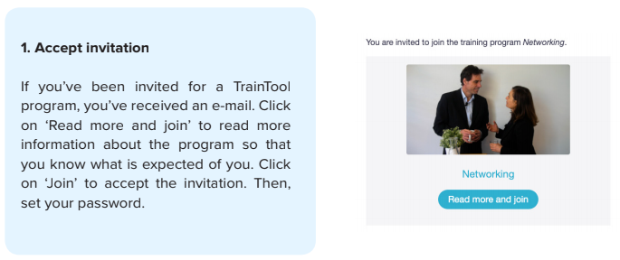
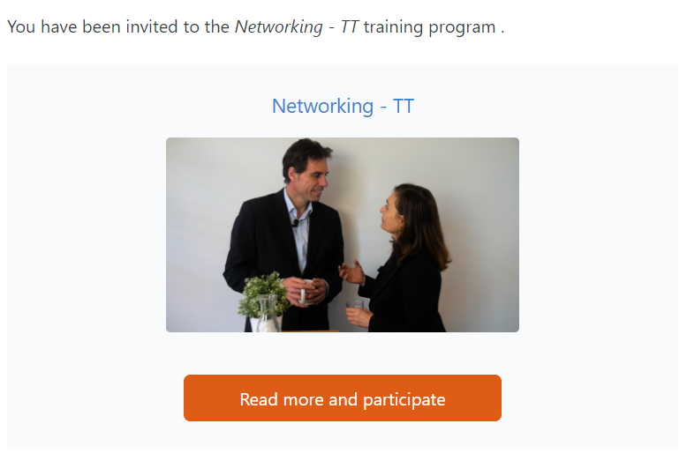
How do I start training?

Slide 12
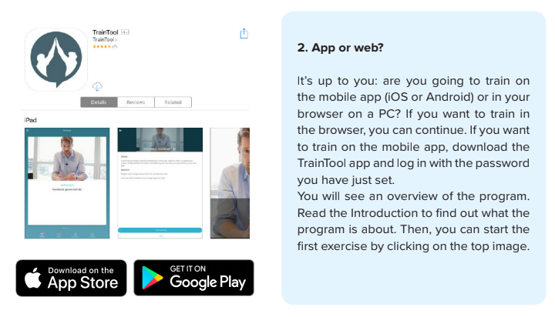
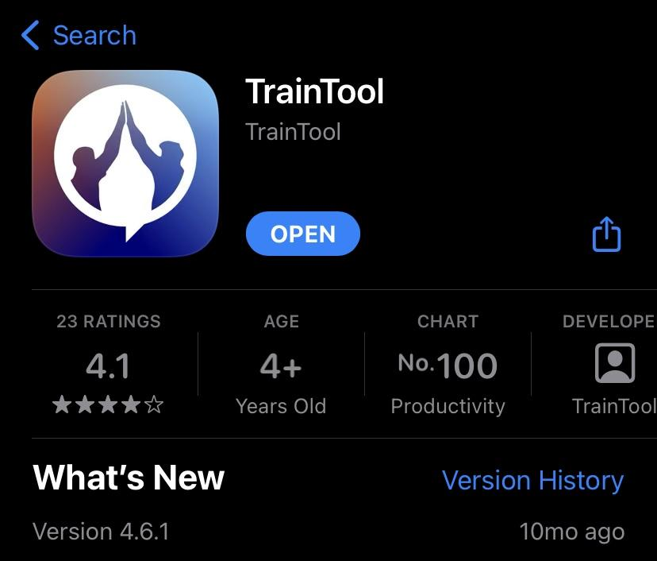
How do I start training?
Tip: TrainTool doesn’t work in Safari, it is necessary for Macbook users to install Google Chrome.

Slide 13
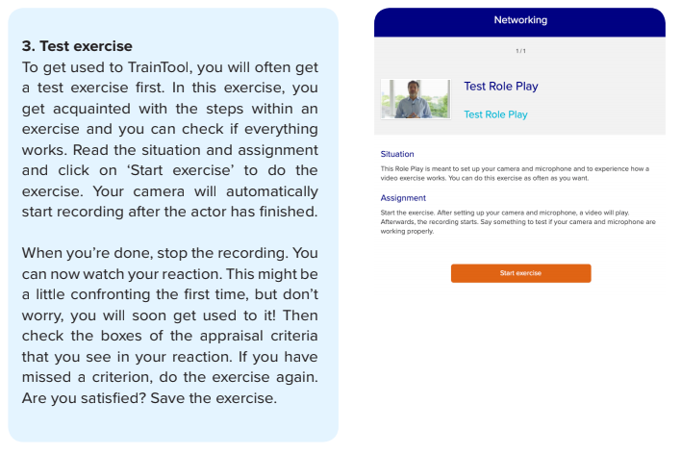
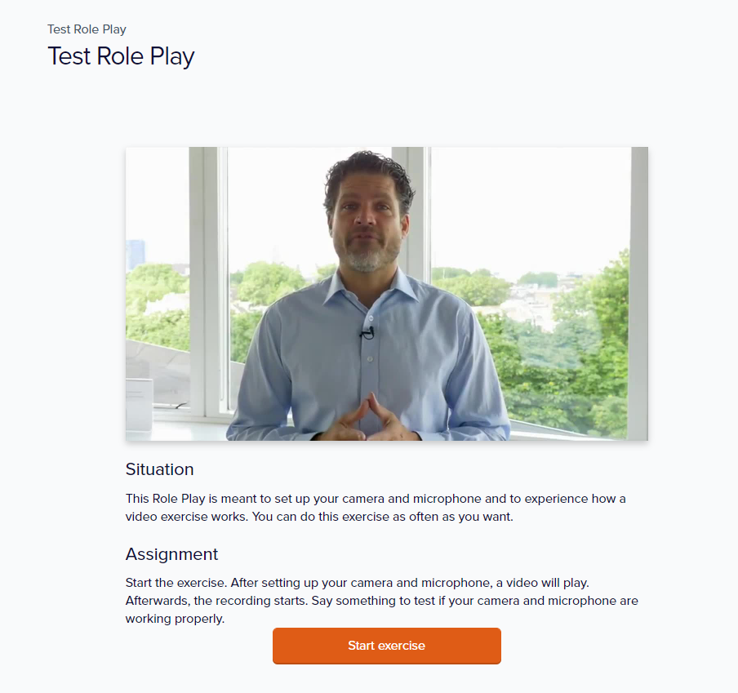
How do I start training?

Slide 14
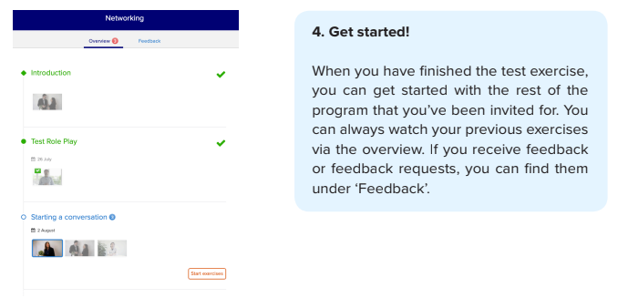
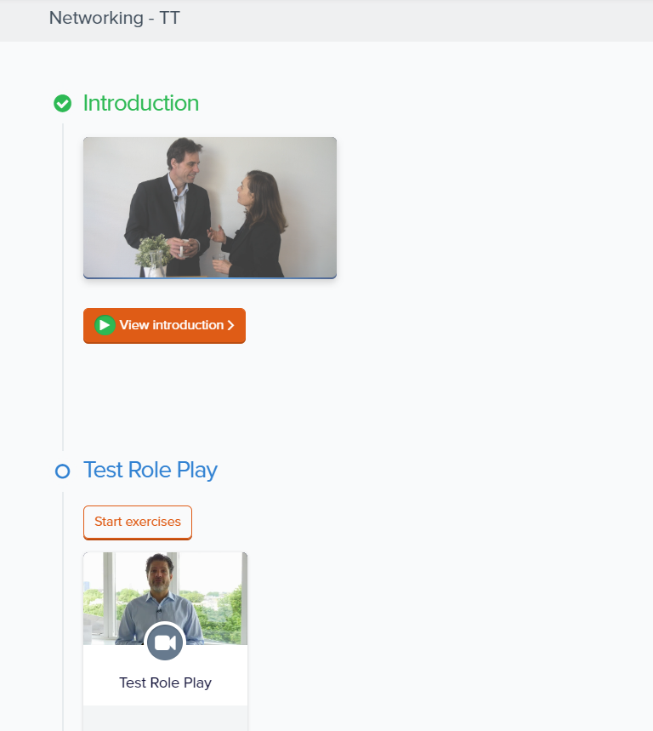
How do I start training?

Slide 15
In case you have any technical questions, for example about logging in, using your camera or microphone or saving recordings, please contact TrainTool’s Support Team:
Email: support@traintool.com
Telehone: 030-8906555
Chat
Good luck practicing in TrainTool!
Questions?

